Slide 1

MONEYCHOICE
CAPITAL
The Future of Quantum Investing
Is Already Here.
Quantum-powered algorithms. 80%+ accuracy since 2016.
A proven edge that Wall Street cannot replicate.
80%+
20+
Prediction Accuracy Since 2016
Years of Proprietary Research
CONFIDENTIAL — FOR ACCREDITED INVESTORS ONLY | moneychoice.us

Slide 2
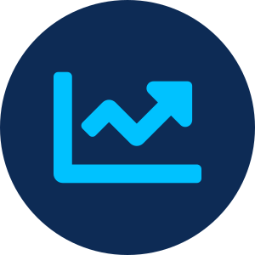



THE PROBLEM
Retail Investors Are
Systematically Outgunned.
No Precision
Algos vs. Humans
Markets move in minutes. Traditional analysis tells you what happened — never what will happen, how much, or by when.
85% of US equity trading is now algorithmic. Retail investors fight institutional machines with nothing but gut feel.
No Accountability
Hidden Manipulation
Social media "gurus" and financial advisors give opinions with zero accountability. Losses are always someone else's fault.
Stocks are artificially pumped and dumped daily. Retail investors are the last to know — and first to lose.
moneychoice.us/capital

Slide 3



THE SOLUTION
MoneyChoice Capital
Quantum Analytics
Quantum-Powered.
Precision Predictions.
Complete Transparency.
Stocks and electrons share probabilistic behavior. Our algorithms model both to find stable price orbits before they form.
MoneyChoice Capital fuses 20+ years of market research, quantum-inspired behavioral analysis, and 7 proprietary IQ algorithms to deliver institutional-grade predictions to every investor — with full public accountability.
80%+ Proven Accuracy
Not backtested simulations — live trades, real money, real accountability. Maintained consistently since 2016.
"Others give opinions on whether a stock will go up. We tell you: AAPL will rise 1.2% within the next 5 days."
Full Transparency
No hidden Discord groups. Every prediction published publicly — wins AND losses — so you can audit our track record yourself.
moneychoice.us/capital

Slide 4
TRACK RECORD
Real Money. Real Trades. Real Results.
80%+
Not simulations. Not backtests. Live-traded performance with full public transparency.
ACCURACY
YELP
RRC
Auto Hedge Fund
40% Profit
40% Upside Captured
8.3% in 2 Months
Oct 30, 2015 — Behavioral analysis detected artificial manipulation weeks before the market. Published publicly on Twitter before the move. Stock declined 40% exactly as forecast, generating significant profits for our users.
Oct 19, 2015 — Published target price of $36.05. Stock hit $36.71 the next day, then crashed to $22.74 by December. A 37% decline accurately predicted — entry and exit both called in advance.
100% automated trading on real brokerage accounts. $830 profit on $10,000 investment. No human intervention — fully algorithmic execution with built-in risk management.
80%+
2,900+
$150M
30+
Top 14
Accuracy Since 2016
Registered Users
Institutional Licensing Deal
Pre-Launch Paying Customers
AI Trading Cos Globally
moneychoice.us/capital

Slide 5
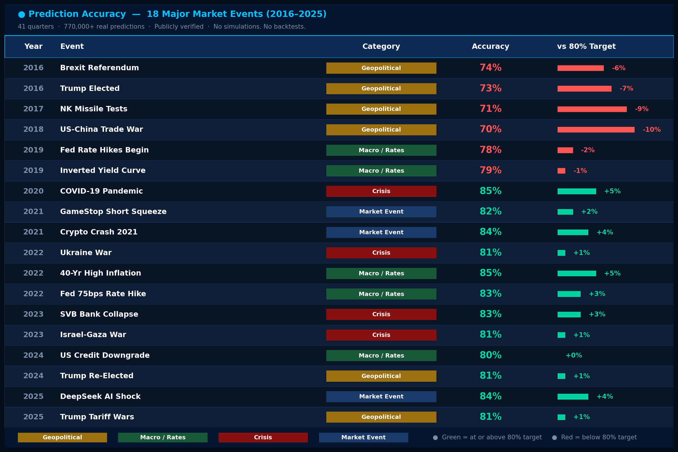
THE CONSISTENCY ADVANTAGE
10 Years. Every Crisis. Same Result.
770K+
80%+
41
85%+
No simulations. Real Trading ideas. Real money — 770,000+ live trades across 41 consecutive quarters.
Predictions
Avg Accuracy
Quarters
Proximity
Consistency
Patterns, Not Macro
Early, Not Reactive
Zero Emotion
Human fear & greed behave identically in every crisis — our algorithms exploit that consistency
We detect manipulation before price moves — positioned before the crowd reacts to news
80B daily computations run identically in a war as in a bull market — no analyst, no opinion
Next crisis — Iran war, Fed shock, AI crash — same algorithms. Same result.
moneychoice.us/capital

Slide 6


MARKET OPPORTUNITY
A Trillion-Dollar Convergence
Quantum finance + retail trading + AI are converging. MoneyChoice Capital sits at the intersection.
$19B
$600B
$11.4T
Quantum Finance
Spending by 2032
Quantum Value in
Financial Services
Global Retail
Trading Volume
72% CAGR — Deloitte
McKinsey 2035 Estimate
Annual US Equity Market
Macro Tailwinds Accelerating Demand
Rise of DIY investing post-COVID: 30M+ new retail brokerage accounts opened 2020–2022
Quantum computing in financial services growing 233x from 2022 to 2032 (Deloitte)
Institutional algorithms dominate 85% of equity trades — retail urgently needs quantum tools
AI-driven trading platforms growing at 35% CAGR — first-mover precision analytics wins
moneychoice.us/capital

Slide 7
COMPETITIVE ADVANTAGE
Competition
Feature
MoneyChoice Capital
Traditional Advisors
AI Signal Apps
Quantum-Inspired Algorithms
✓
✗
✗
80%+ Verified Live Accuracy
✓
✗
✗
Manipulation Detection
✓
✗
✗
Full Public Transparency
✓
Rare
✗
Automated Hedge Fund
✓
✗
✗
Consistent Results — All Conditions
✓
✗
✗
20+ Yrs Proprietary Research
✓
✗
✗
Our core moat is not the algorithms alone — it is 20+ years of validated, real-money performance data that trains and continuously improves them. That dataset cannot be bought, copied, or fast-tracked.
moneychoice.us/capital

Slide 8

OUR MOAT — WHY COMPETITORS CANNOT REPLICATE US
Why not AI, why Quantum ?
Everyone is doing AI to get “quick wins” which works sometimes, however not “consistently”
Uncertainty & Probability
Wave + Particle Duality
✗ AI FAILS HERE
✓ QUANTUM WINS
✗ AI FAILS HERE
✓ QUANTUM WINS
Fits curves to history. Markets don't repeat — they evolve.
Models probability ranges, not single guesses — like markets actually move.
Treats price as signal OR event. Misses the transitions between them.
Models wave and trade layers simultaneously — catches breakouts early.
→
→
Measurement Defines State
Entanglement-Like Correlation
✗ AI FAILS HERE
✓ QUANTUM WINS
✗ AI FAILS HERE
✓ QUANTUM WINS
Ignores that big orders, news, and volume spikes actively move prices.
Every large trade and market event instantly updates our model state.
Static correlations break when regimes shift. AI doesn't adapt in time.
Assets modeled as a live coupled system — sector move triggers instant portfolio recalculation.
→
→
20 years of quantum-trained data · 7 proprietary IQ algorithms · 80B daily computations · Cannot be bought, copied, or fast-tracked
moneychoice.us/capital

Slide 9


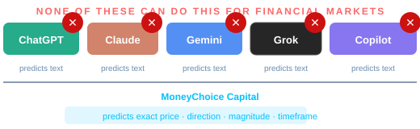
THE LLM QUESTION
PREDICTS TEXT
GPT predicts text. We predict exact price moves.
Not Prices
Can’t ChatGPT
Just Do
This?
HALLUCINATES
LLMs hallucinate financial data. Wrong calls cost real money.
We Never Do
0 LIVE TRADES
Zero live trades ever. We have 10 years of verified proof.
No.
We Have 10 Yrs
PUBLIC DATA ONLY
Public internet data only. We have 10 yrs of proprietary trades.
We Own Ours
BLIND TO MANIPULATION
Our 80 Billion daily computations catch it first.
We Detect It
moneychoice.us/capital

Slide 10
TRACTION & MILESTONES
A 20-Year Journey. Perfected. Now Scaling.
Market research
begins
YELP & RRC —
first public wins
App launch,
2,900+ users
Security breach
→ rebuild stronger
Acquired
TINO IQ
2004
2015
2017
2019
2025
2009
2016
2018
2021
2026
TINO IQ
founded
80%+ accuracy
milestone
$150M
Institutional deal
80B daily
computations
Seed Round —
Scale globally
Huffington
Post
2,900+
30+
Featured In
App Users
Paying Customers
Pre-Marketing
moneychoice.us/capital

Slide 11


THE QUESTION EVERY INVESTOR ASKS
"If you're
so good,
why do you
need VC?"
We Win Either Way
We execute and grow with or without this funding. The algorithm works today. Funding doesn't fix a broken product — it accelerates a proven one.
Speed is the Only Variable
Without funding: we reach $2.4M ARR in 3-4 years organically. With funding: we get there in 12-18 months. You're not saving us — you're compressing time.
Fair question.
Scale Requires Infrastructure
Here's the honest answer.
Marketing to 6,667 subscribers, building the auto-trading hedge fund, and closing institutional licensing deals all require capital. The algorithm is free. Distribution isn't.
We Want the Right Partners
We're not raising because we're desperate. We're raising because the right investor brings networks, credibility, and access to institutional clients that money alone can't buy.
moneychoice.us/capital

Slide 12
REVENUE MODEL
Multiple High-Margin Revenue Streams
All driven by our core moat: consistent, verifiable prediction accuracy.
01
02
SaaS Subscriptions
Automated Hedge Fund
$2.4M/yr Target
AUM-Based Fees
Gold Plan: $30/mo — 100+ predictions daily
6,667 subscribers = $2.4M ARR
Just 0.013% of 50M US retail traders
100% algorithmic execution
No human manager risk
2% mgmt + 20% performance fees
03
04
Institutional Licensing
Partnership & White-Label
$150M Deal Signed
Enterprise Contracts
Proprietary API access for banks,
fintechs & hedge funds
Ex-Goldman deal closed 2018
White-label analytics for brokers
and wealth management platforms
Exclusive territory agreements
50M US retail traders → 0.013% converting → 6,667 Gold subscribers → $2.4M ARR → 84% net margin

Slide 13
INVESTMENT OPPORTUNITY
$2M Seed Round
at $20M Pre-Money Valuation
We execute and win with or without funding. Investment accelerates the timeline.
35%
30%
20%
15%
$700K
$600K
$400K
$300K
Marketing &
User Acquisition
Auto-Trading
Hedge Fund Capital
Algorithm R&D
& Quantum Infra
Partnership &
Licensing Deals
Month 6
Year 1
Year 2
Year 3
200 Gold users
$72K ARR
500 Gold + licensing
$720K ARR
1,000 Gold + 17 inst. deals
$2.4M ARR
$10M+
Revenue
Investor Returns Path
Year 1–2: 1,000 Gold @ $30/mo = $360K ARR + $2.04M institutional licensing = $2.4M ARR (just 0.002% of 50M US retail traders)
Year 3: 1,000 Gold ($360K) + institutional licensing scale → $10M+ revenue potential
Exit: Strategic acquisition by fintech, brokerage or quantum firm at 10–20x revenue multiple
moneychoice.us/capital

Slide 14
MONEYCHOICE
CAPITAL
Join the Revolution
The Quantum Edge
Is Now Investable.
Raise
$2,000,000
Valuation
$20,000,000
80%+ verified accuracy — maintained since 2016 across all market conditions
Instrument
Seed / SAFE
Fully owned IP — 20+ years of live trade data that cannot be reverse-engineered
Min. Check
$100,000
Multiple revenue paths — SaaS, hedge fund, institutional licensing & partnerships
invest@moneychoice.us
moneychoice.us/capital
CONFIDENTIAL — FOR ACCREDITED INVESTORS ONLY | moneychoice.us

