Slide 1
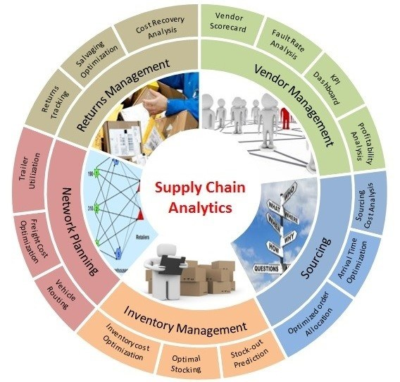
Some questions people ask us:
How much would this product sell next quarter ?
Can I increase the price without losing demand ?
Would making new product cannibalize sales of current product ?
Do you think economy would hold up next year ?
How much inventory to keep so that I can fulfil & not have waste
Got limited supply: Should I give it to Customer A or B ?
Should I make in USA or China or Mexico or India
How much is currency risk ?
What happens if Inflation picks up or goes down ?
Impact of consumer confidence / monetary / fiscal policies
and many more
Money Choice
Supply
Chain
Analytics

Slide 2

Cognitive Demand Forecasting
Forecast accuracy from 82% to 95%
Business hierarchy / SKU / Component level predictions
Good for hardware SKU’s – Best for software recurring SKU’s
Real time industry / market sentiment
100+ Macro-Economic & Customer demand features
What-If scenarios/answers - Quarterly & Monthly Predictions

Slide 3

How does “Cognitive” differ from traditional AI / ML / Causal
It’s cognitive because in addition to analyzing historical patterns, it also would learn to “alter” the future and “self-learn” to optimize combinations for finding what works for a customer across dimensions like time, region, technology.
For ML experts, additionally, Cognitive would identify “true” causal factors with “evidence” – not just correlated features
Cognitive = Next version of Artificial Intelligence
(Personalized AI based on customer, time, product mix)

Slide 4

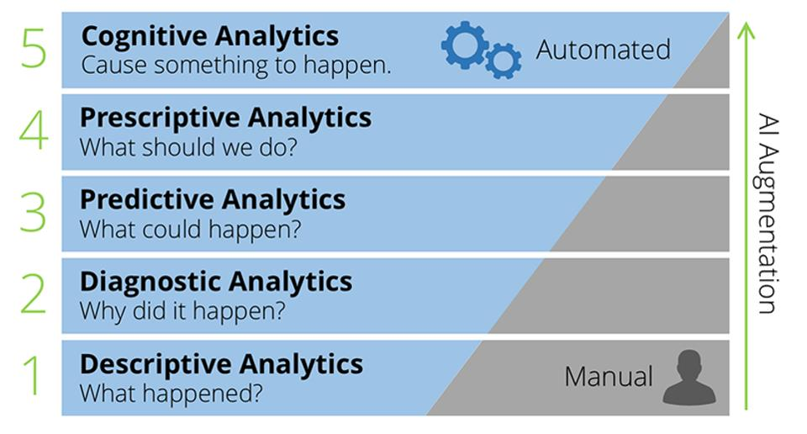
Why cognitive ?
Simulate “human thought processes” in a quantitative model
Basic machine learning would not able to predict future “accurately” because :
Business volatility are not easily captured by machine learning because of “changing nature of business”
“Microscopic” decision by various teams – Good for me, is it good for others ?
Cognitive = Does not ‘replicate’ mistakes of human decisions. Evolves and corrects itself by each interaction
Understand customers erratic patterns (satisfaction , purchase, predictability)

Slide 5
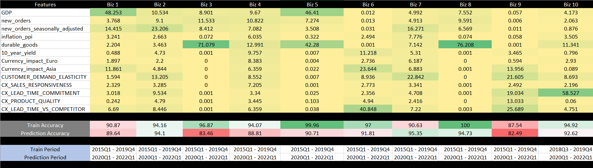
Forecasting accuracy for 10 businesses
Results
All numbers above are in percentages
Each biz above is over $100 million in revenue

Slide 6
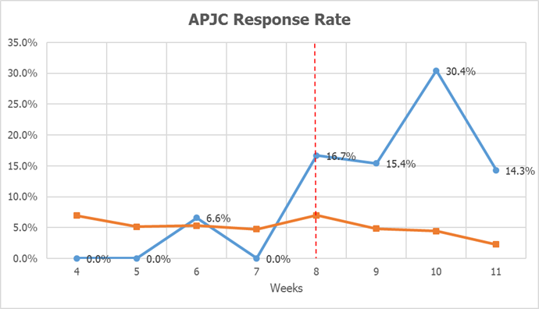
Customer Engagement – Increasing Sales
Results
Response Rate by Region / Weeks
Weeks | APJC | EMEAR & AMERICAS
4 | 0.0% | 7.0%
5 | 0.0% | 5.1%
6 | 6.6% | 5.3%
7 | 0.0% | 4.7%
8 | 16.7% | 7.0%
9 | 15.4% | 4.8%
10 | 30.4% | 4.4%
11 | 14.3% | 2.3%
Selectively targeting customers to increase engagement
Dotted line shows time when CDF was applied on 2000+ APJC customers
Response rate APJC
Response rate AMERICAS and EMEA
Response rate by Fiscal Weeks

Slide 7
More areas to apply Cognitive Forecasting
High Customer Engagement
Reduce Supply Chain Bottlenecks
Better engagement with your customers & Increase quality of response rate
Customer centric Order fulfillment
Who drives what - Lead time vs Booking
Precise Demand Forecasting
Develop Customer Personas / Motivation to buy from your company
Full product lifecycle, sentiment, Competition
Price, Quality, Cause, Loyalty, Technology, Personality, Engagement, Sentiment
Escalation Risk Prediction
Plan future with your customers
Prevent escalations & expedites before they occur
Help your customers understand their own future needs and how you fulfil those commitments
Supply Chain
meets
Customer

Slide 8
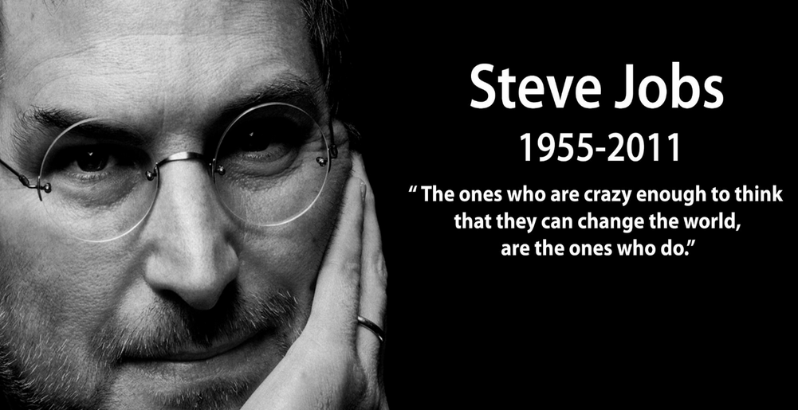
Don’t predict future
rather
Shape your future:
“The way you want it to be”

